Slide 1
Concurrent Programming
IT 301

Slide 2
Introduction
Concurrent programming

Slide 3
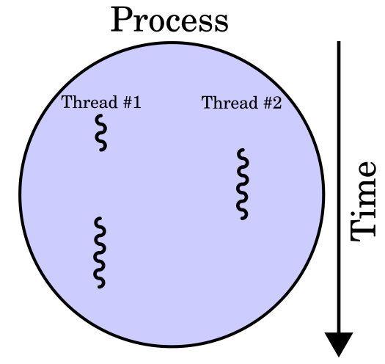
What is a thread?
An executable unit in your application
Lightweight process
Designed to execute code concurrently
Shares memory within a process

Slide 4
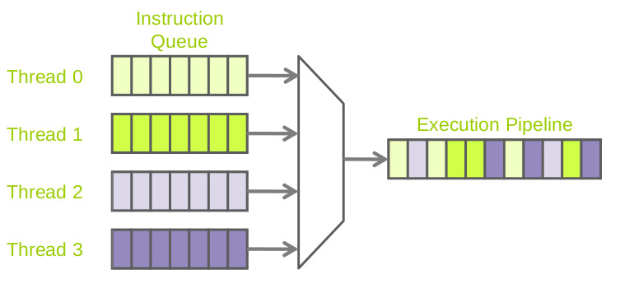
Thread scheduling
Thread scheduler
A component of the JVM
Responsible for managing the time each Thread gets to execute instructions on a CPU

Slide 5

Terminology
Context switch: switching from one thread to a different thread on the CPU
All thread specific data (Java call stack, variables, etc…) need to be saved
Time slice (quantum): the amount of time a thread is allowed to execute instructions on a CPU

Slide 6


Thread scheduling
Cooperative Scheduler
Preemptive Scheduler
No context switches (no interrupts)
A thread is responsible for releasing control of the CPU
Each thread is given a time slice (quantum) on the CPU
Determines when a time slice has elapsed and a context shift should occur

Slide 7
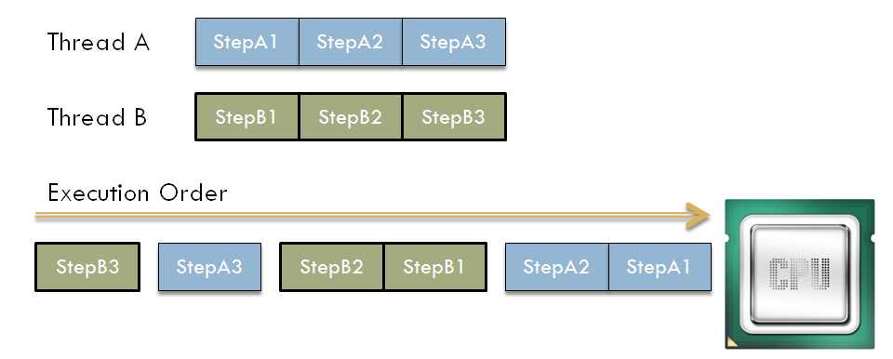
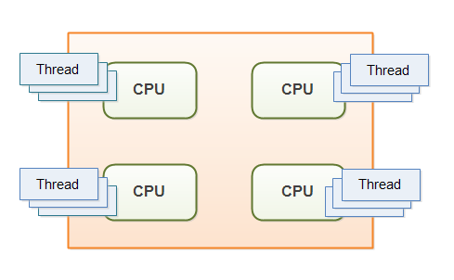
Interleaved and parallel processing
On a single processor all operations are interleaved
On a multi-core processor operations can run in parallel

Slide 8
Creating Threads
Concurrent programming

Slide 9


Solving problems with threads
Goal: simultaneous actions
Text editor – spell checker
GUI applications – data model/business logic
Game engine – artificial intelligence
Goal: to maximize CPU usage when solving problems
Input/output problems
Long network (HTTP) requests
File IO
Interacting with peripherals
Print job requests
Scanner request

Slide 10
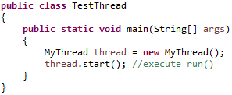
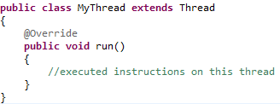
The Thread class
Creating a new Thread
Define a class that extends from java.lang.Thread
Override the run() method
Starting the Thread
Call start() on an instance of your new class

Slide 11
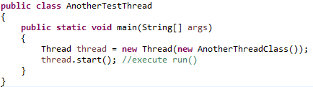
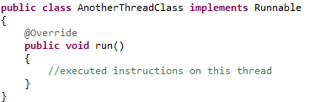
Alternative: the Runnable interface
Creating a new thread
Define a class that implements java.lang.Runnable
Implement the run() method
Starting the thread
Pass your Runnable class as an argument to the constructor in Thread

Slide 12
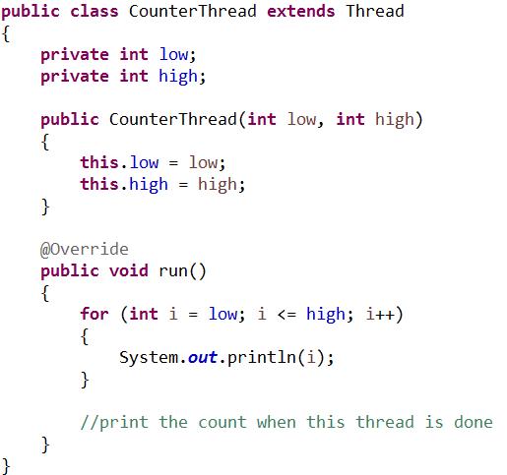
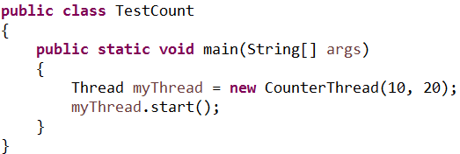

A simple thread problem
Create a thread that counts from low to high, where low & high are positive integers and low < high

Slide 13

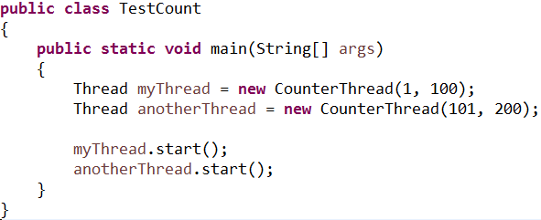
Example thread computation
Simultaneous actions
Unpredictable results

Slide 14
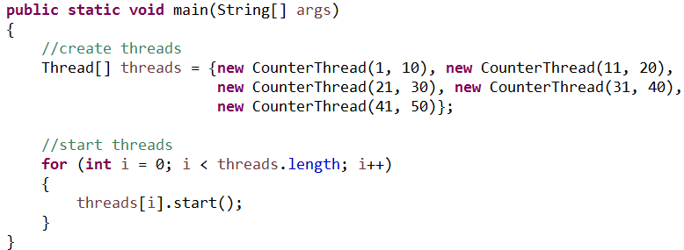
Example thread computation
Starting groups of threads

Slide 15

Try it! (part one)
Create a thread that stores a string and prints it out to the Java Console
You can use the Thread class or Runnable interface to start your thread
Create an instance of your Class in a driver class and start your thread
Thread
<<interface>>
Runnable
PrinterThread
Printer Runnable

Slide 16
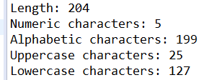
Try it! (part two)
Alter your thread to print out statistics based on the characters in your string:
the string length
total numeric digits
total alphabetic characters
total lowercase letters
total uppercase letters
Note: The Character class has several useful methods for inspecting char values.
For example:
public boolean Character.isDigit(char input)
Example output:
Example input:
“1: Phenomenal Woman by Maya Angelou
2: Where the Sidewalk Ends by Shel Silverstein
3: If You Forget Me by Pablo Neruda
4: I carry your heart with me by E. E. Cummings
5: The Road Not Taken by Robert Frost”

Slide 17

Try it! (part three)
Break up your input string into several strings (one per line)
Create one thread per line and run them simultaneously
What is your output?
What challenges are presented?
Example input:
String one = “1: Phenomenal Woman by Maya Angelou”
String two = “2: Where the Sidewalk Ends by Shel Silverstein”
String three = “3: If You Forget Me by Pablo Neruda”
String four = “4: I carry your heart with me by E. E. Cummings”
String five = “5: The Road Not Taken by Robert Frost”

Slide 18
Capturing results
Concurrent programming

Slide 19
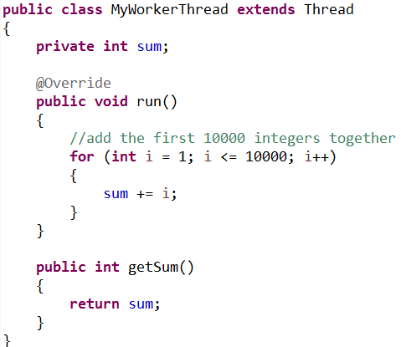
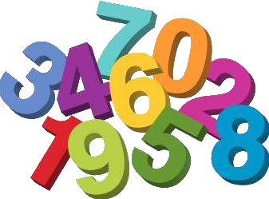
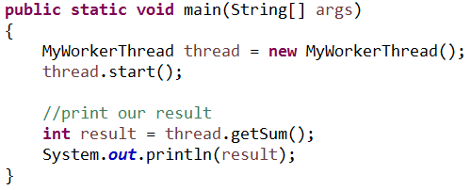
Capturing results
What is our
expected result?

Slide 20

Race conditions
Definition: A race condition occurs when the correctness of a computation depends on the relative timing or interleaving of multiple threads.

Slide 21

Concurrency
Each Java program starts with a primary thread
Any other thread that is started represents a branch in our program execution
Concurrent execution
Main thread
Computation thread

Slide 22
Concurrency
Immediate requests for results follow a consecutive mentality (rather than concurrent)
Main thread
Immediate request
for results
Computation thread
Work started
Work ended

Slide 23
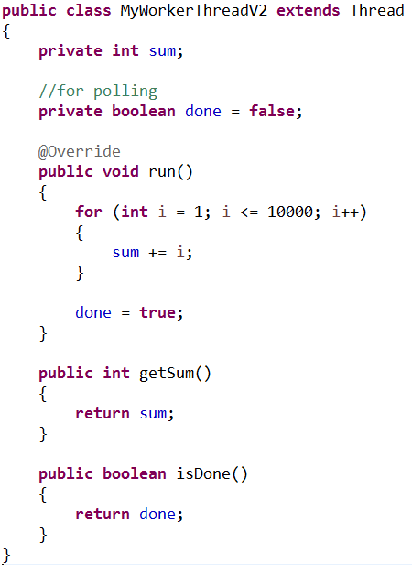
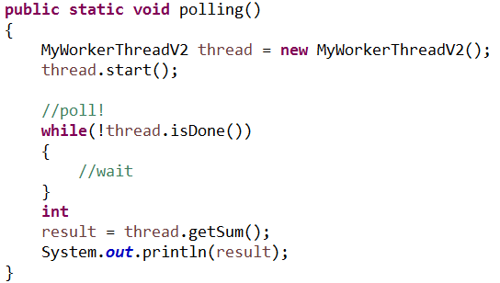
Strategies for retrieving results
Polling
Loop until you detect your result
Benefits? Drawbacks?
Unneeded use of the CPU
Constant requests

Slide 24
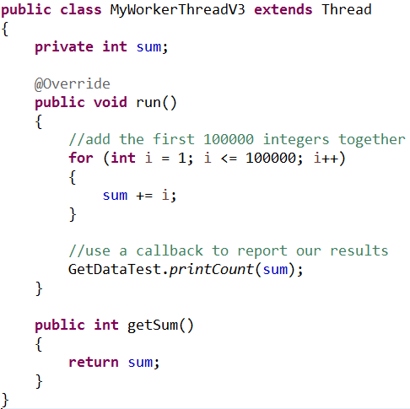
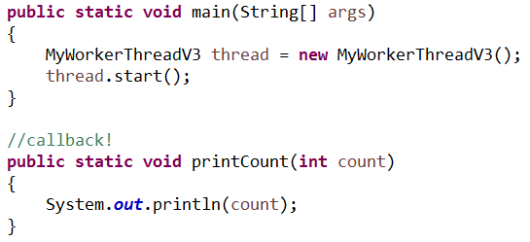
Strategies for retrieving results
Callbacks
Let the thread invoke a method to announce work completion
Easier to do in languages with method pointers (ie. not Java)
Benefits? Drawbacks?
Can create tight coupling between classes

Slide 25
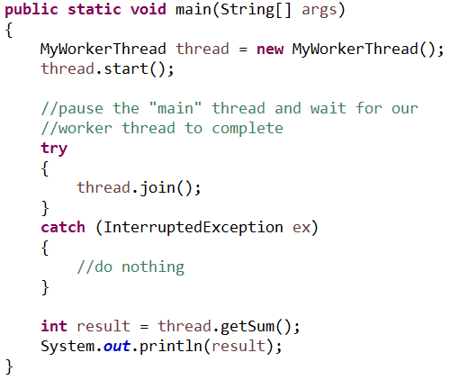
Strategies for retrieving results
Using Thread.join()
Forces the current thread into a waiting state until a secondary thread terminates (ie. run() has completed)
The current thread will then resume execution

Slide 26
Thread properties
Concurrent programming

Slide 27
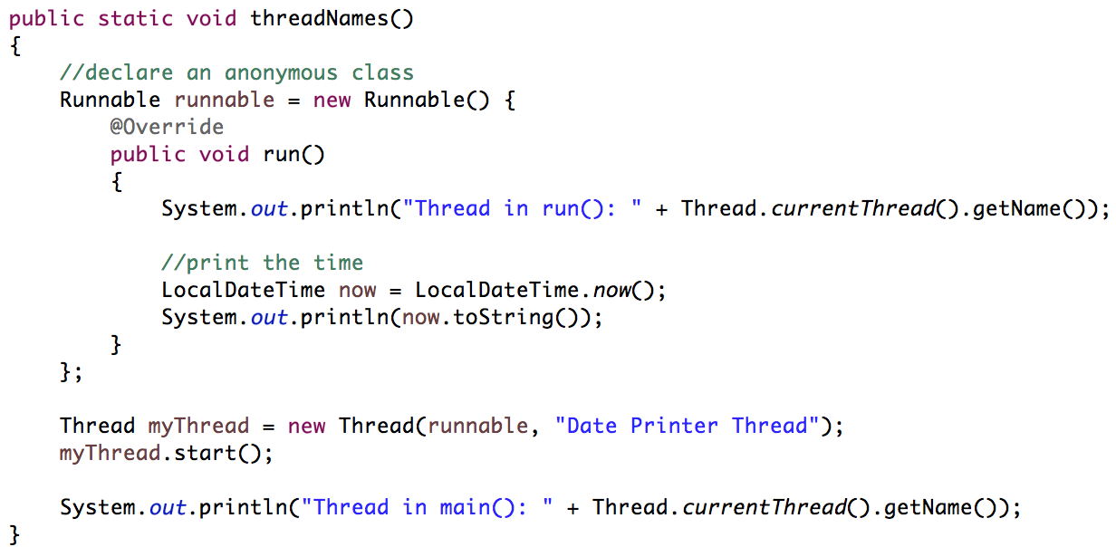

Thread names
Threads can be given names
Useful for debugging
Retrieving the current
thread’s name.
Thread creation with
an anonymous class.
Setting a Thread name
The primary thread is called ”main”

Slide 28
Thread states
New
Runnable
Waiting
Timed Waiting
Terminated
Ready
Running
Blocked
a thread which has not yet started
Ready: waiting on scheduler for next chance to use CPU
Running: executing on CPU
a Thread that has completed execution
a blocked Thread that does not execute until a necessary resource is available
a Thread that does not execute as it waits for a notify signal from an object
similar to a waiting state with an added timeout

Slide 29
Thread state transitions
Scheduler chooses thread
run()
ends
new
start()
ready
running
terminated
Scheduler suspends thread or yield()
sleep(), wait(), join()
waiting
notify(), notifyAll(), timeout elapsed
wait(), join()
timed waiting
notify(), notifyAll()
Try to acquire lock
blocked
lock acquired

Slide 30
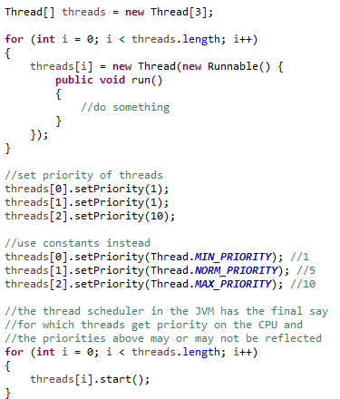
Thread priorities
Thread can be given a priority
Higher priority threads are given more CPU time
Priorities are integers in the range [1, 10]
A priority is not guaranteed to influence the scheduler
Dependent on the JVM

Slide 31
Sleeping a thread
Threads available for execution wait in a ready queue that the JVM Thread Scheduler manages
Threads can enter a waiting or blocked state and are removed from the ready queue
A timed waiting state can be achieved with the following methods
Thread.sleep(x): enters a waiting state for x milliseconds
Thread.interrupt(): exits a waiting state begun with a call to Thread.sleep()
Scheduler chooses thread
ready
running
Scheduler suspends thread or yield()
Thread.sleep()
waiting
Thread.interrupt() or timeout elapsed

Slide 32
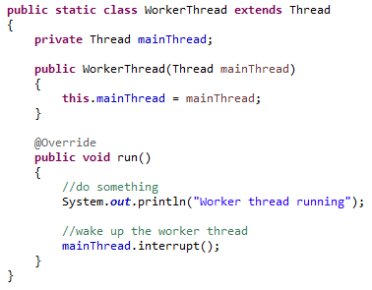
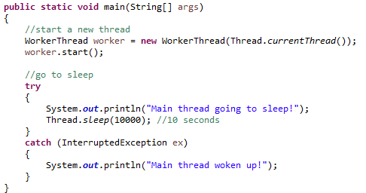

Sleeping a thread
worker thread
runnable
“main” thread
waiting
“main” thread
runnable

Slide 33


Try it!
Created a timed story book tale using Threads
Create a secondary thread to tell your story to the Java console
On your primary thread:
Start your thread and then call join() on your story thread
Print “And they lived happily ever after!” on your main thread after your call to join()
On your secondary thread:
Print “Welcome to my storybook!”
Wait for 2 seconds
Print “The story began long, long ago”
Then print ten periods (.) to the console, waiting ½ second after each character. Each of your periods should be on the same line.
Print a new line character to end your story

Slide 34
Yielding a thread
A healthy concurrent systems require threads to behave well together
Yielding a thread removes the current thread from execution and puts the thread back on the ready queue
Note: this forces a context shift, where the current thread gives up it’s time slice on the CPU
Note: the thread can still be chosen from the ready queue at a later point by the scheduler
Scheduler chooses thread
ready
running
Scheduler suspends thread or yield()

Slide 35
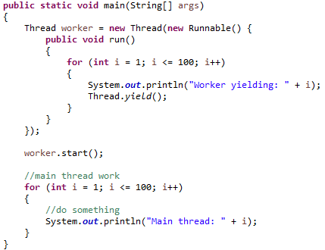
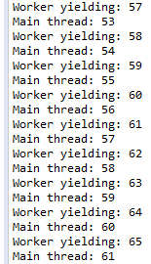
Yielding a thread
Let other threads
have time to execute
on CPU

Slide 36
Synchronization
Concurrent programming

Slide 37
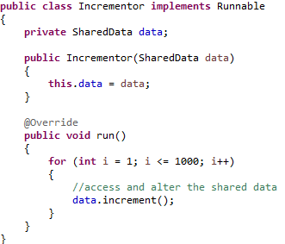
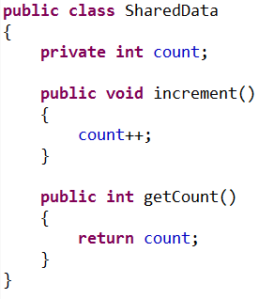
Data is shared between threads
Unlike processes, threads share a single memory space
Any interaction with shared memory can result in
Unpredictability
Corrupted data
Lost updates
Threads interact with data
Create shared
data
What are the expected results if you start three threads?

Slide 38

Lost updates
Is increment safe?
count++; is short-hand for count = count +1;
There are three steps here:
Retrieve the value in count
Increment this value by 1
Assign the result to count

Slide 39
Scenario
1.
Thread
Scheduler
Retrieve count: 3
interrupt!
ThreadA
3.
Increment count: 4
Reassign
Shared Data
count = 3 → 4
count = 3 → 4
Shared Data
count = 3
2.
Shared Data
count = 3 → 4
ThreadB
Retrieve count: 3
Increment count: 4
Reassign

Slide 40
Critical regions and monitors
Definition: A critical region contains data that is accessed/changed by more than one thread.
Definition: A monitor (lock, semaphore) guards a critical region and manages access to shared resources.
Definition: A mutex is a monitor that provides mutually exclusive access to a critical region.
Lock
Shared data

Slide 41
Locks
“Like a door that guards access to a room (code segment). Only a single person (thread) can be in the room at one time. When a person leaves the room, a new person (thread) that is waiting can enter the room.”
Shared data
Thread
Thread
Thread
Thread
Thread
blocked state (ie. waiting for the lock)
runnable state (ie. owns the lock)

Slide 42

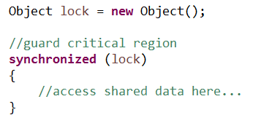
Synchronization in Java
Any Java object can behave as a lock (mutex) on a critical region
To ensure mutual exclusion you must use the same lock for critical region

Slide 43
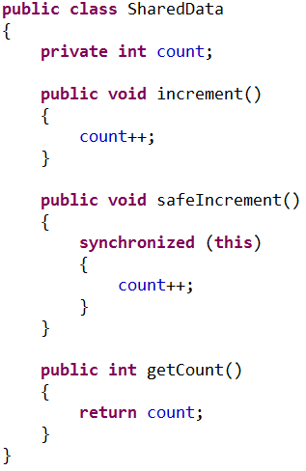
Synchronization in Java
Solving the lost updates problem
Use the SharedData object as a lock.
Mutually
exclusive
access
Will complete
without interruption

Slide 44
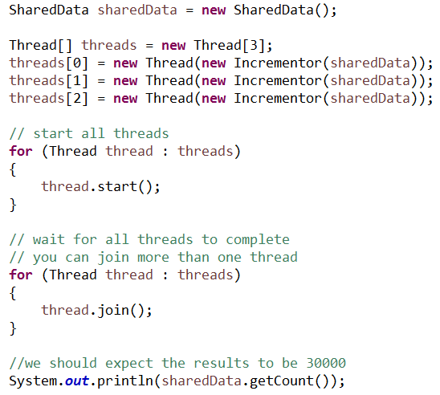
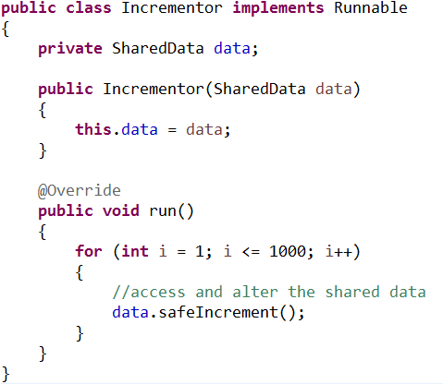

Synchronization in Java
Solving the lost updates problem

Slide 45
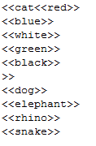
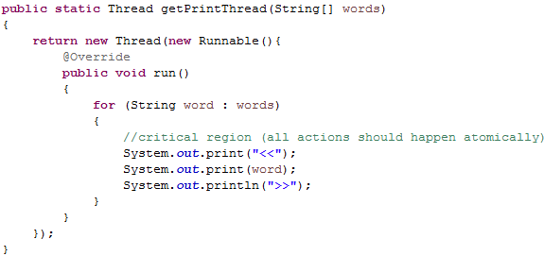
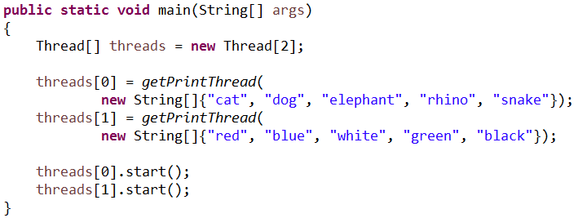
Another example
Synchronizing actions
What will be the output below?

Slide 46
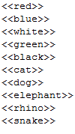
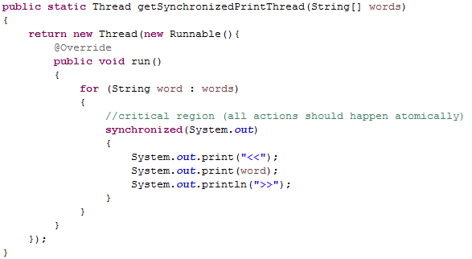
Another example
Synchronizing actions
Using System.out as a lock

Slide 47
Thread safety
Definition: A class is thread-safe when it continues to behave correctly when accessed from multiple threads.
Question: Is Java’s ArrayList class thread-safe?
How can we know?
Java API
Test for predictable results during concurrent access

Slide 48
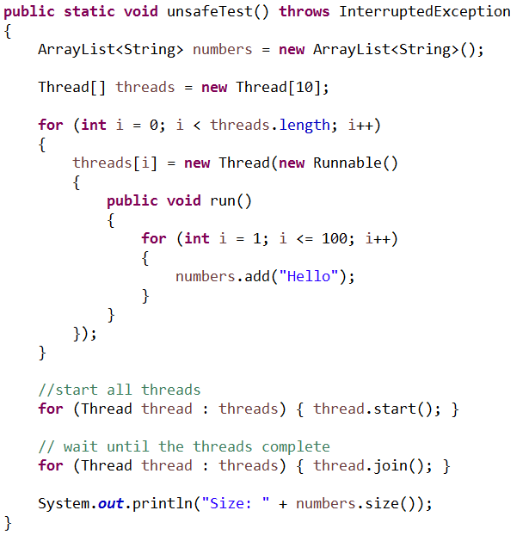
Example
What should be the output if the array list is behaving predictably?

Slide 49
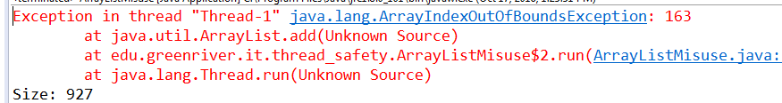
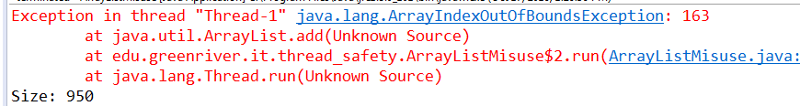
Example
What should be the output if the array list is behaving predictably?

Slide 50
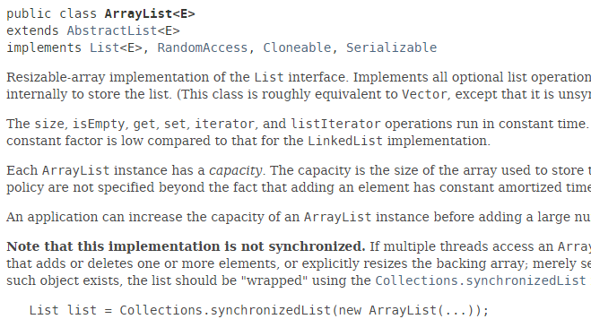
Example
What should be the output if the array list is behaving predictably?

Slide 51
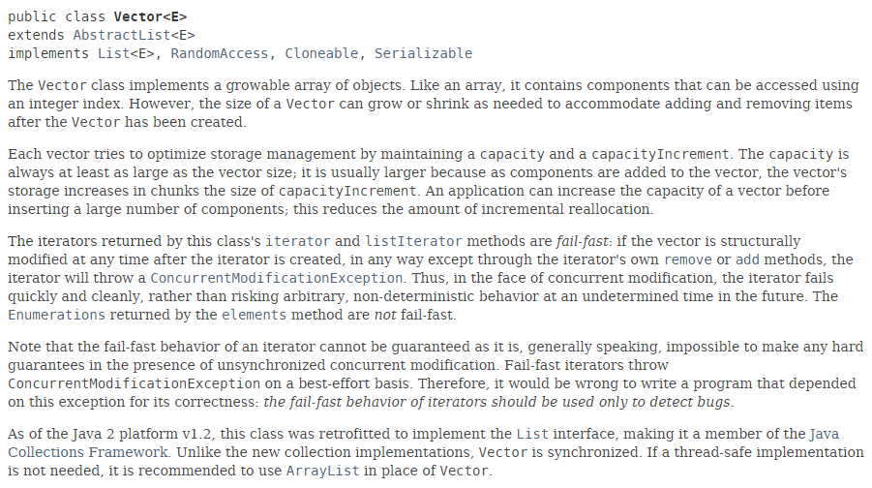
The Vector class
Alternative to the ArrayList class

Slide 52
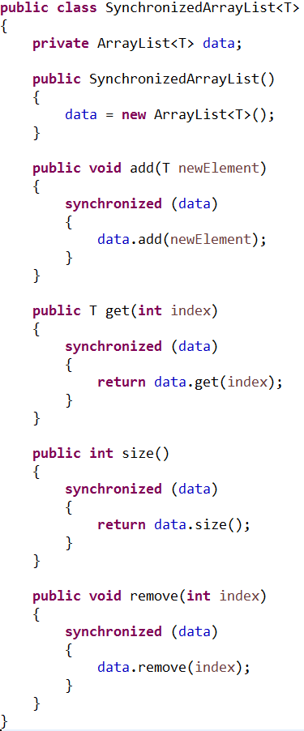
Creating a thread safe class
All data stored in the class must be hidden behind a single lock (typically)
Each synchronization block should be as small as possible
Any requests for data can block all other threads trying to access the same data

Slide 53
Deadlock
Concurrent programming

Slide 54
What is deadlock?
Definition: deadlock occurs when two threads each hold a resource (lock) and then block forever attempting to access the resource (lock) owned by the other thread
ThreadA
ThreadB
waits for
lock
waits for
lock
gains
lock
gains
lock
LockA
LockB
Shared Data
Shared Data

Slide 55
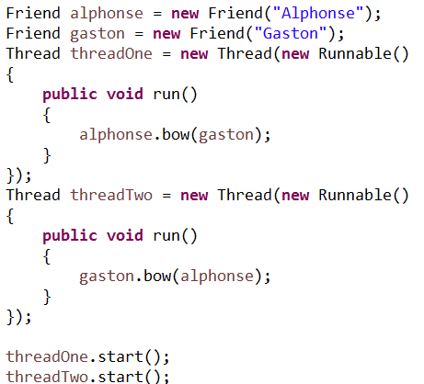
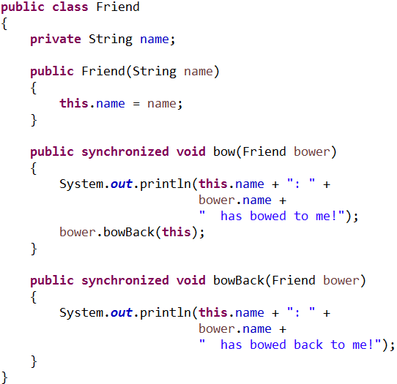
An example

Slide 56
An example
Alphonse
Gaston
1. alphonse.bow(gaston)
4. alphonse.bowBack(gaston)
3. alphonse.bowBack(gaston)
AlphonseLock
GastonLock
Shared Data
Shared Data
2. gaston.bow(alphonse)

Slide 57

How to avoid deadlock?
Reduce the number of synchronized blocks
Reduce the size of synchronized blocks
Make sure that locks are gained in the same order

Slide 58
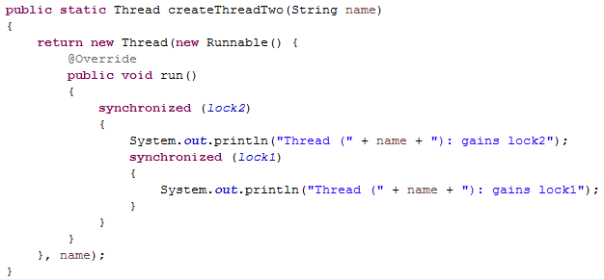
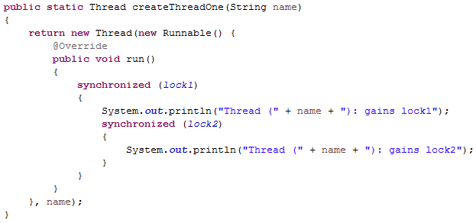
Ordering locks

Slide 59

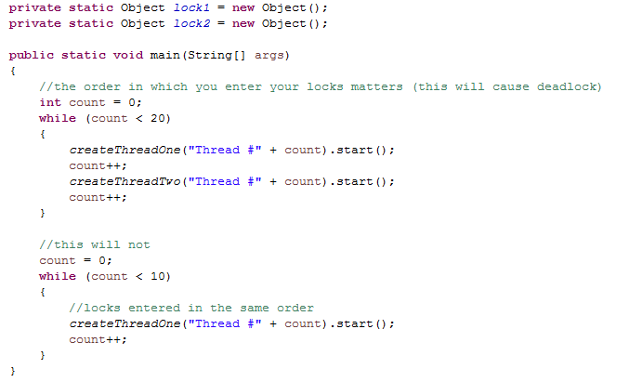
Ordering locks
One thread
was successful
Each object
has what the
other needs

Slide 60
Alternatives to synchronization
Concurrent programming

Slide 61
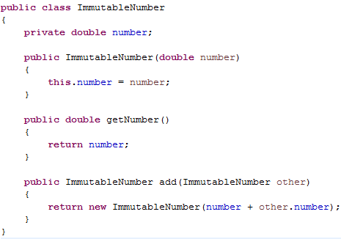

Alternatives
Encapsulation
Inaccessible data is harder to share among threads
Use immutable classes
Immutable objects cannot change after instantiation

Slide 62


Alternatives
Use thread-safe types from java.util.concurrent.atomic
These types guarantee an update occurs atomically (in one step, without interruption)

Slide 63

Alternatives
Use wrapper classes
Collections.synchronizedList(list) will create a new thread-safe list object
Similarly, Collections.synchronizedMap() and Collections.synchronizedSet() will create Map and Set variants

Slide 64
The producer/consumer pattern
Concurrent programming

Slide 65
Producers and consumers
The producer/consumer pattern is a well known solution for managing:
A queue of data
Producer threads generate data items on the queue
Consumer threads remove data items from the queue (for processing)
Process items
Producer
Thread
Create items
Consumer
Thread
Producer
Thread
Consumer
Thread
Producer
Thread
Consumer
Thread
Data Queue

Slide 66
Producers example
Should our queue be fixed size?
Producer
Thread
Place orders
What happens if we have no consumers?
Producer
Thread
Producer
Thread
Online Order Queue
Register customer
Add line items
Verify addresses
Verify funds
Does the speed of each producer affect our problem?

Slide 67
Example
Fulfill orders
Producer
Thread
Place orders
Consumer
Thread
Producer
Thread
Consumer
Thread
Producer
Thread
Consumer
Thread
Data Queue
Notify customer
Generate receipt
Box items
Ship items

Slide 68
Design challenges
Scenario #1: The producer threads are quicker than consumer threads.
We will use up too much memory as the queue grows
A bounded queue will become full
Scenario #2: The consumer threads are quicker than producer threads.
Our queue will become empty
Full!
Producer
Thread
Place orders
Empty!
Fulfill orders
Consumer
Thread

Slide 69
wait() and notify()
Any Java object can act as message-passing monitor
To delay execution (wait) until a message is passed to an object, call wait() on the object
To enable execution on delayed threads, call notify() on the associated object

Slide 70
Example
Working
zzz...
Working
Thread
Thread
1. wait()
3. respond to notify()
Monitor
(lock)
2. notify()
Thread

Slide 71

Code example
Reading and printing words from a file
Producer: reads words from file and adds them to a shared queue

Slide 72

Code example
Consumer: retrieves words from a shared queue and prints them

Slide 73

Code example
Shared queue

Slide 74


Code example
Driver and output

Slide 75
Thoughts?
Can we speed up our input to the queue with more producer threads?
Can we speed up our output from the queue with more consumer threads?
Print word
Producer
Thread
Read file
Consumer
Thread
Producer
Thread
Consumer
Thread
Producer
Thread
Consumer
Thread
Word List

Slide 76
Concurrent Programming
IT 301

